Slide 1
GPP 2022:
An Editor’s Perspective
Zoe Preston, MPhil
Nucleus Global, Oxford, UK

Slide 2
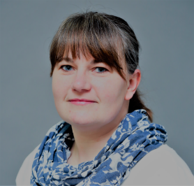
Speaker: Zoe Preston
I am an employee of Nucleus Global, an Inizio company
The opinions expressed in this presentation are mine
About me
23 years’ experience in Medical Communications and STM publishing
Currently lead the Editorial Support Services team in Nucleus Global in the EU
Specialist in copyright and tackling predatory publishing
Involved with GPP 2022 as an Editor and layout coordinator

Slide 5
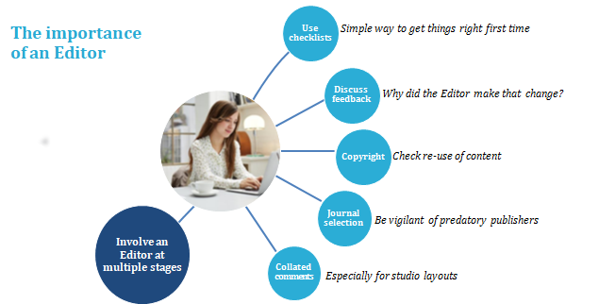

Slide 7
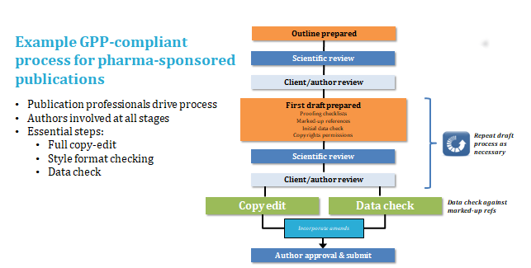

Slide 8
Thank you

